Slide 1


Just-in-Time (JIT) Compilation on Embedded Hardware
CSA1405 – Compiler Design With ANTLR
- Slot B
Project by :
A.Krishna Koushik(192210479)
Challa Mohith Reddy(192211724)
SSE,SIMATS

Slide 2

Just-in-Time (JIT) Compilation on Embedded Hardware
Just-in-Time (JIT) compilation is a powerful technique for optimizing software performance on embedded hardware. This presentation explores the benefits, challenges, and techniques involved in JIT compilation for embedded systems.
kk

Slide 3

Introduction to JIT Compilation
JIT compilation is a technique where code is compiled to machine code at runtime, just before execution. This is in contrast to Ahead-of-Time (AOT) compilation, where code is compiled before runtime.
1
Dynamic Compilation
2
Performance Optimization
JIT compilation allows for dynamic code generation based on runtime conditions, such as the target platform and program inputs.
JIT compilation optimizes code for the specific hardware and software environment in which it will run, resulting in performance gains.
3
Flexibility and Adaptability
4
Code Security
JIT compilation provides flexibility by allowing code to be tailored to the specific requirements of different platforms.
JIT compilation can enhance code security by dynamically obfuscating code or performing runtime checks to prevent malicious attacks.

Slide 4
Advantages of JIT Compilation
JIT compilation offers several advantages for embedded systems, making it a valuable tool for optimizing software performance.
Improved Performance
Enhanced Flexibility
Reduced Memory Footprint
JIT compilation allows for runtime code optimization, leading to significant performance gains.
JIT compilation enables code to adapt to different hardware and software environments, improving flexibility.
JIT compilation can minimize the memory footprint by dynamically loading and compiling only the necessary code segments.

Slide 5

Challenges of JIT Compilation on Embedded Systems
Despite its benefits, JIT compilation presents unique challenges when implemented on embedded systems.
Resource Constraints
Real-time Requirements
Embedded systems often have limited memory, processing power, and energy budgets, which pose constraints on JIT compilation.
JIT compilation must be performed within real-time constraints to avoid delays in application execution.
Power Consumption
JIT compilation can increase power consumption due to the overhead of dynamic code generation and execution.

Slide 6

Dynamic Code Generation Techniques
JIT compilation relies on dynamic code generation techniques to create optimized machine code at runtime.
Interpreter-based
Bytecode Interpreter
JIT compiler translates bytecode into machine code at runtime.
Method-based
Method Inlining
JIT compiler optimizes code by combining frequently called methods into a single function.
Profile-guided
Dynamic Profiling
JIT compiler gathers runtime profiling data to identify hot spots and optimize code based on execution patterns.

Slide 7




Memory Management Considerations
Efficient memory management is crucial for JIT compilation on embedded systems, where resources are limited.
Garbage Collection
Garbage collection algorithms are used to reclaim unused memory and prevent memory leaks.
Memory Allocation
Dynamic memory allocation strategies are employed to manage the allocation and deallocation of memory blocks at runtime.
Memory Compression
Memory compression techniques reduce the amount of memory required to store code and data, freeing up valuable resources.

Slide 8




Achieving High Performance on Embedded Platforms
High performance is critical for many embedded applications, and JIT compilation can play a significant role in achieving this goal.
Code Optimization
JIT compilers use various optimization techniques to generate highly efficient machine code.
Instruction Scheduling
JIT compilers optimize instruction scheduling to minimize execution time and improve performance.
Hardware-specific Optimizations
JIT compilers can leverage hardware-specific features, such as SIMD instructions and cache optimization, to further enhance performance.

Slide 9
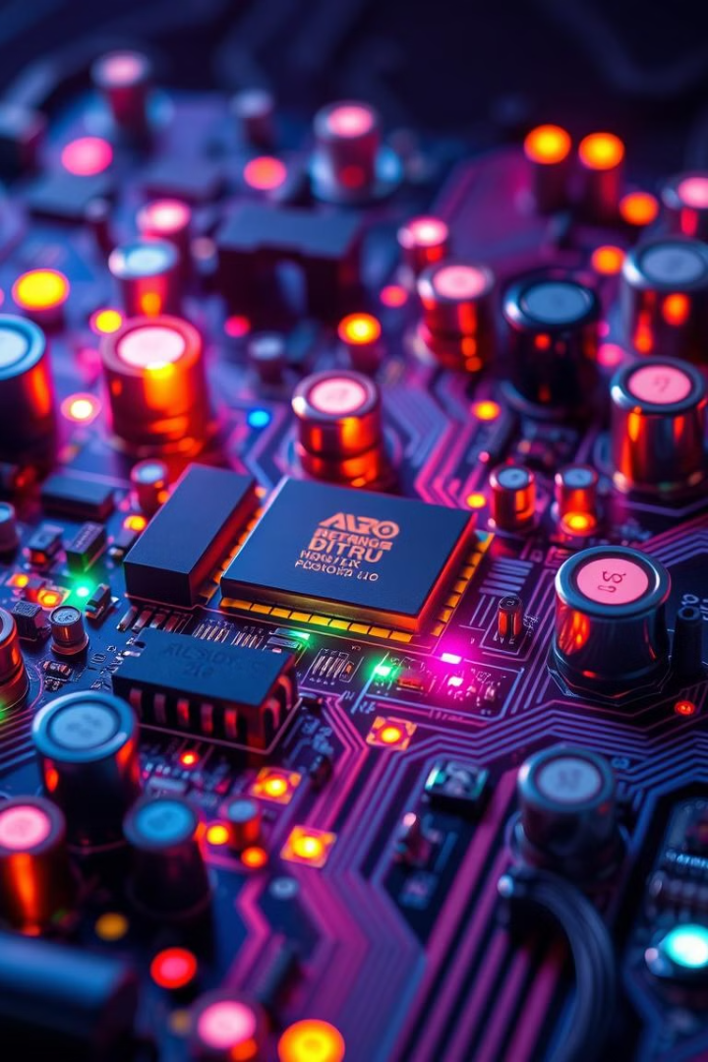
Optimizing for Power Efficiency
Power efficiency is a critical consideration for embedded systems, especially for battery-powered devices.
1
Low-power JIT Compilation
JIT compilers can be designed to minimize power consumption during dynamic code generation and execution.
2
Power-aware Optimization
JIT compilers can dynamically adjust code optimization levels based on power constraints, trading performance for power efficiency.
3
Power Profiling
JIT compilers can collect runtime power profiling data to identify power-intensive code segments and optimize them for reduced power consumption.

Slide 10


Real-world Case Studies and Benchmarks
Several real-world case studies demonstrate the effectiveness of JIT compilation on embedded systems.
Mobile Devices
Autonomous Vehicles
JIT compilation is used in mobile operating systems to improve the performance of apps.
JIT compilation is used in autonomous vehicles to optimize the performance of complex algorithms for navigation and decision-making.

Slide 11

Future Trends and Research Directions
Research in JIT compilation for embedded systems is continuously evolving, with new trends and research directions emerging.
1
Adaptive JIT Compilation
2
Hardware-Assisted JIT
Hardware support for JIT compilation is being explored to accelerate the process of dynamic code generation.
JIT compilers are becoming more adaptive, dynamically adjusting their optimization strategies based on runtime conditions.
3
Security-Enhanced JIT
Research is ongoing to enhance the security of JIT compilation, preventing malicious attacks and ensuring code integrity.

Slide 12


